Slide 1
NYC Taxi Trip Duration Analysis
Final Project - CS6240 Data Mining
Jiahui Luo
Qin Yin
Zhe Feng

Slide 2

Introduction
What is the problem?
Why it's important?
Who might benefit from the model?

Slide 3
Dataset
What dataset ?
Kaggle
How large is it ?
train.csv - the training set (contains 1458644 trip records)
test.csv - the testing set (contains 625134 trip records)

Slide 4
Dataset - Data Fields
id - a unique identifier for each trip
vendor_id - a code indicating the provider associated with the trip record
pickup_datetime - date and time when the meter was engaged
dropoff_datetime - date and time when the meter was disengaged
passenger_count - the number of passengers in the vehicle (driver entered value)
pickup_longitude - the longitude where the meter was engaged
pickup_latitude - the latitude where the meter was engaged
dropoff_longitude - the longitude where the meter was disengaged
dropoff_latitude - the latitude where the meter was disengaged
store_and_fwd_flag - This flag indicates whether the trip record was held in vehicle memory before sending to the vendor because the vehicle did not have a connection to the server - Y=store and forward; N=not a store and forward trip
trip_duration - duration of the trip in seconds

Slide 5
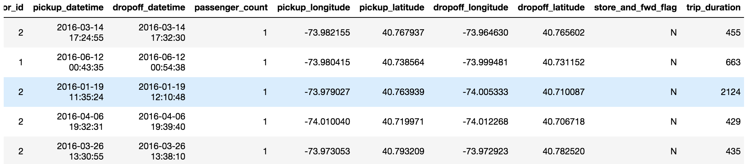
Dataset

Slide 6
Data Exploration
Trip Duration:
count 1.458644e+06 mean 9.594923e+02 std 5.237432e+03 min 1.000000e+00 25% 3.970000e+02 50% 6.620000e+02 75% 1.075000e+03 max 3.526282e+06 Name: trip_duration, dtype: float64
Number of Passengers:
Passengers: 0 to 8
pickup_datetime bounds:
2016-01-01 00:00:17 to 2016-06-30 23:59:39
dropoff_datetime bounds:
2016-01-01 00:03:31 to 2016-07-01 23:02:03
Latitude bounds:
34.359695434570305 to 51.88108444213867
Longitude bounds:
-121.9333038330078 to -61.33552932739258

Slide 7
Data Exploration
Trip Duration: min 1 s max 3526282 s Name: trip_duration, dtype: float64
1s or 40.8 days for one trip
Number of Passengers:
Passengers: 0 to 8
No Passengers

Slide 8
Data Preprocessing
Trip Duration Clean-up:
m = np.mean(train['trip_duration'])
s = np.std(train['trip_duration'])
train = train[train['trip_duration'] <= m + 2*s]
train = train[train['trip_duration'] >= m - 2*s]
Check for duplicates:
print('No of Duplicates, Trip IDs: {}'.format(len(train) - len(train.drop_duplicates(subset='id'))))
Check Missing Values:
print(train.isnull().sum())
print(test.isnull().sum())
Passenger Count Clean-up:
print('Empty trips: {}'.format(train[train.passenger_count == 0].shape[0]))
train = train[train.passenger_count > 0]
print('Dropped trips with no passengers')

Slide 9
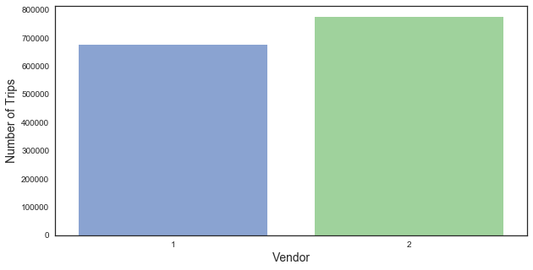
Distribution of Vendors

Slide 10
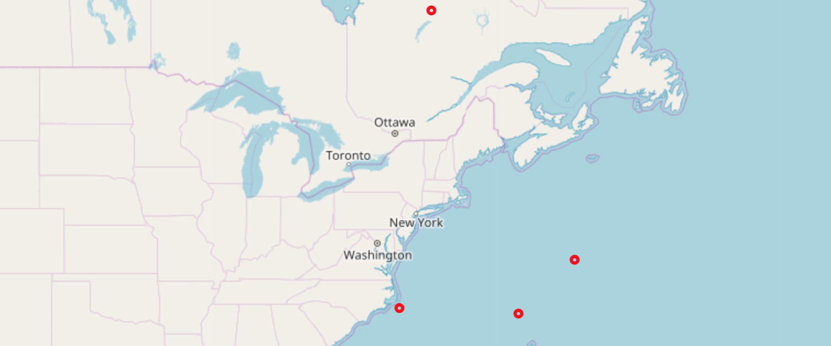
Data Exploration
Latitude bounds:
34.359695434570305 to
51.88108444213867
Longitude bounds:
-121.9333038330078 to
-61.33552932739258

Slide 11
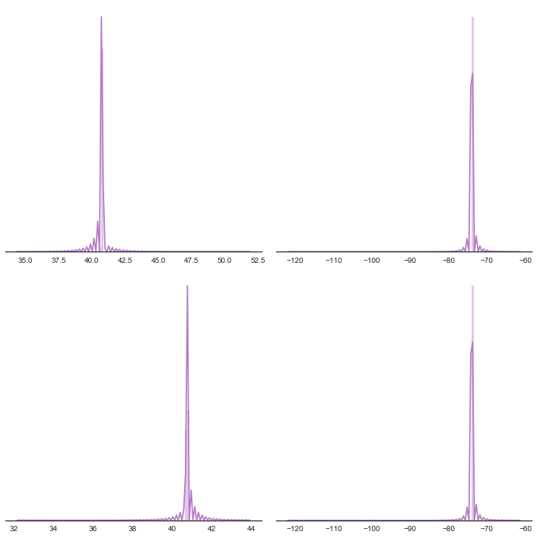
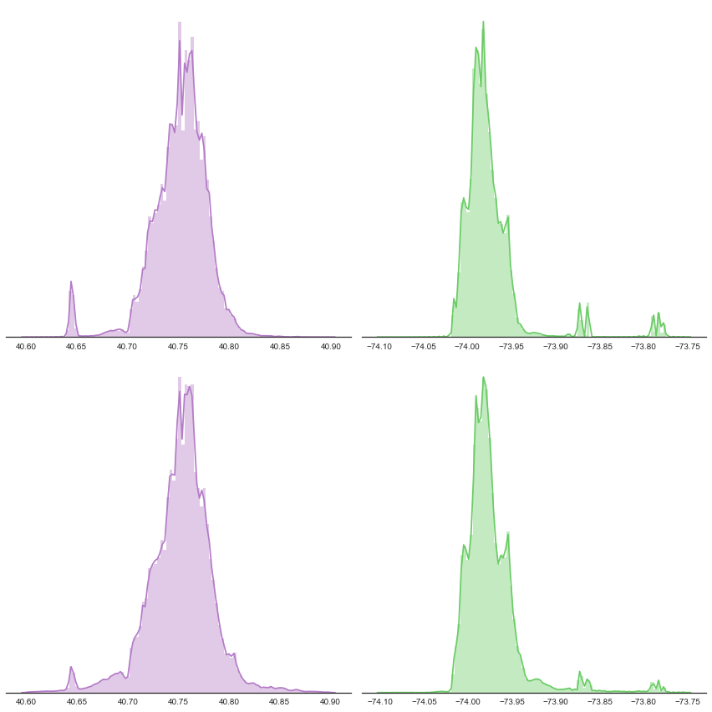
Data Preprocessing- Clean-up:
latitude should be between 40.6 to 40.9
Longitude should be between -74.10 to -73.75
latitude
longitude
latitude
longitude
latitude
longitude
latitude
longitude

Slide 12
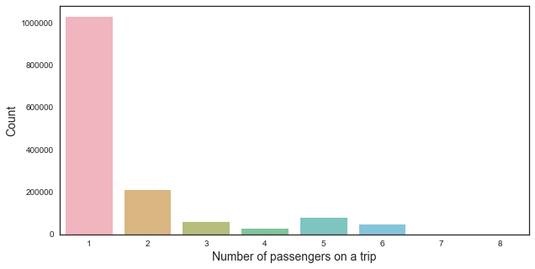
Distribution of Passenger Count

Slide 13
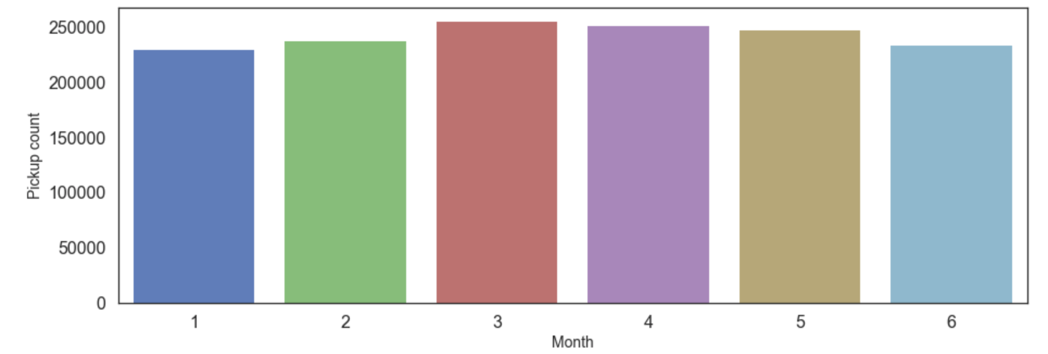
Distribution of Pickup Count over the Year

Slide 14
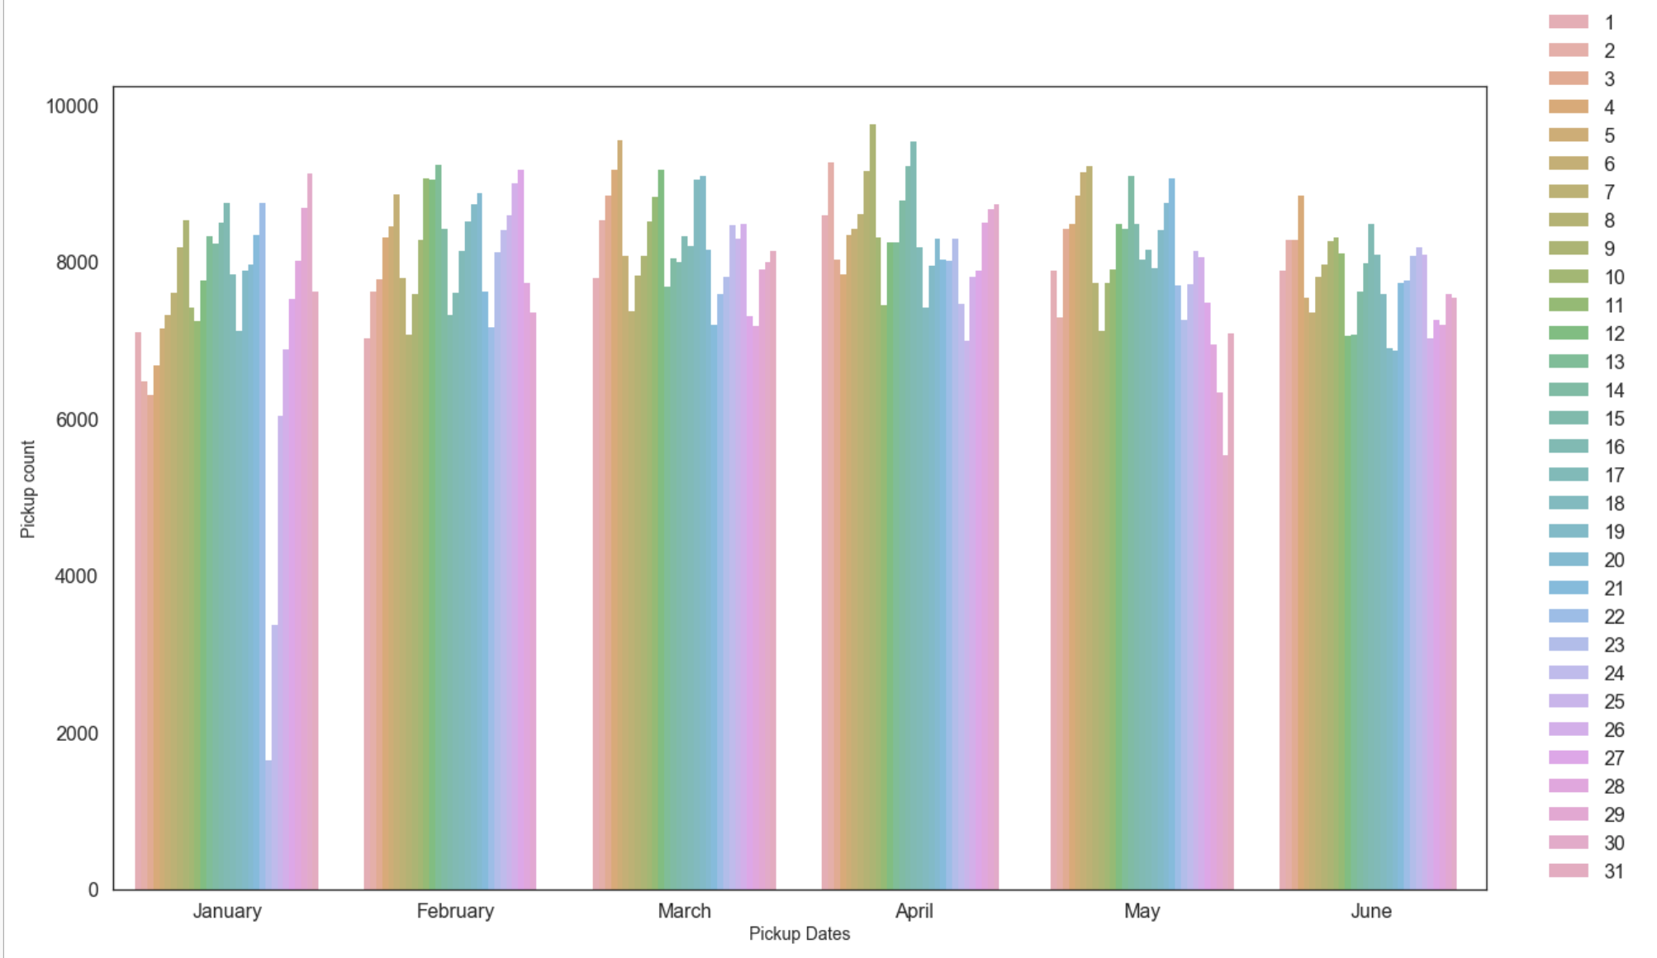
Distribution of Pickup Datetime over the Year

Slide 15
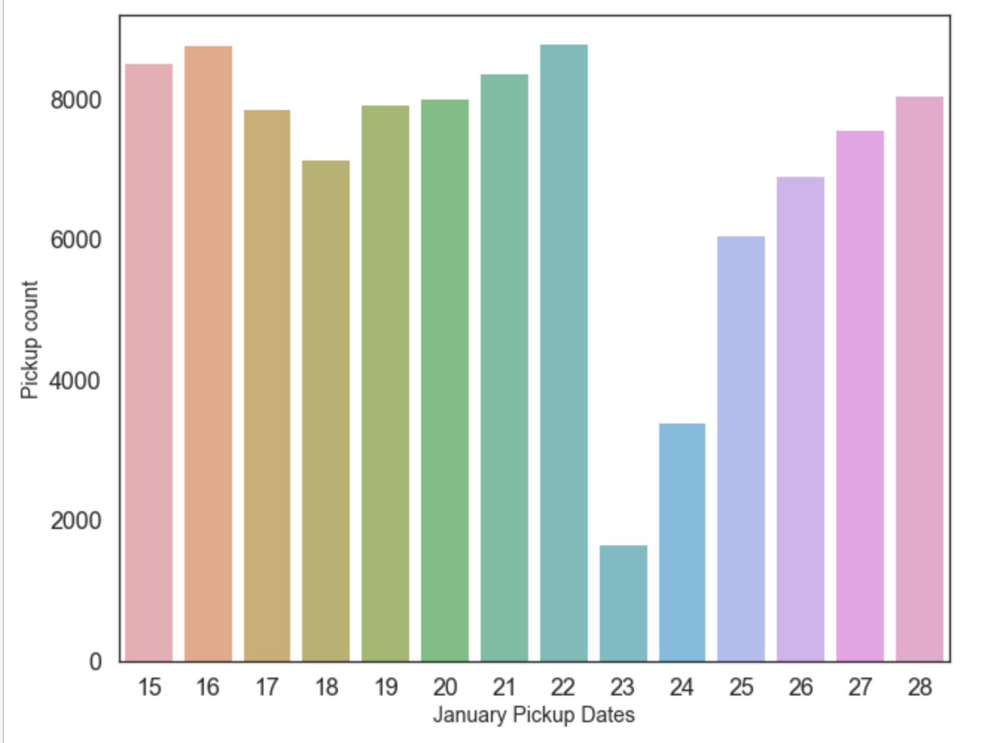
Distribution of Pickup Datetime over January

Slide 16

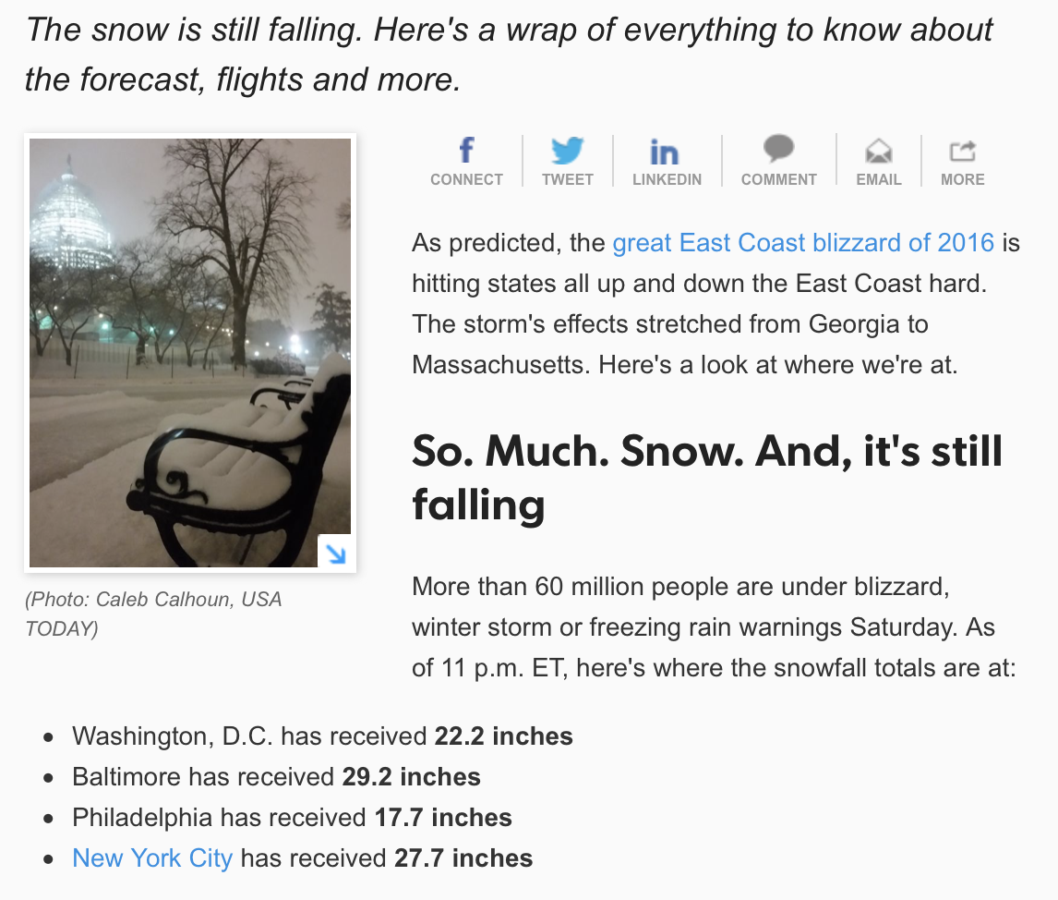

Slide 17
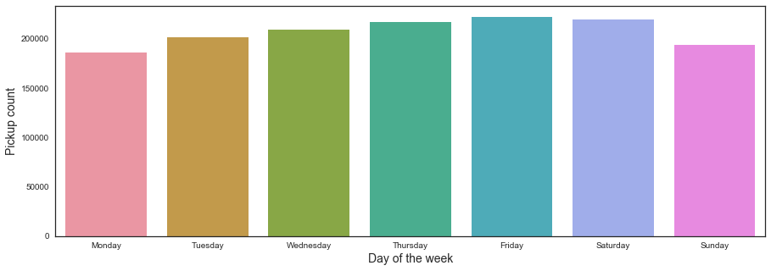
Distribution of Pickup Count over the Week

Slide 18
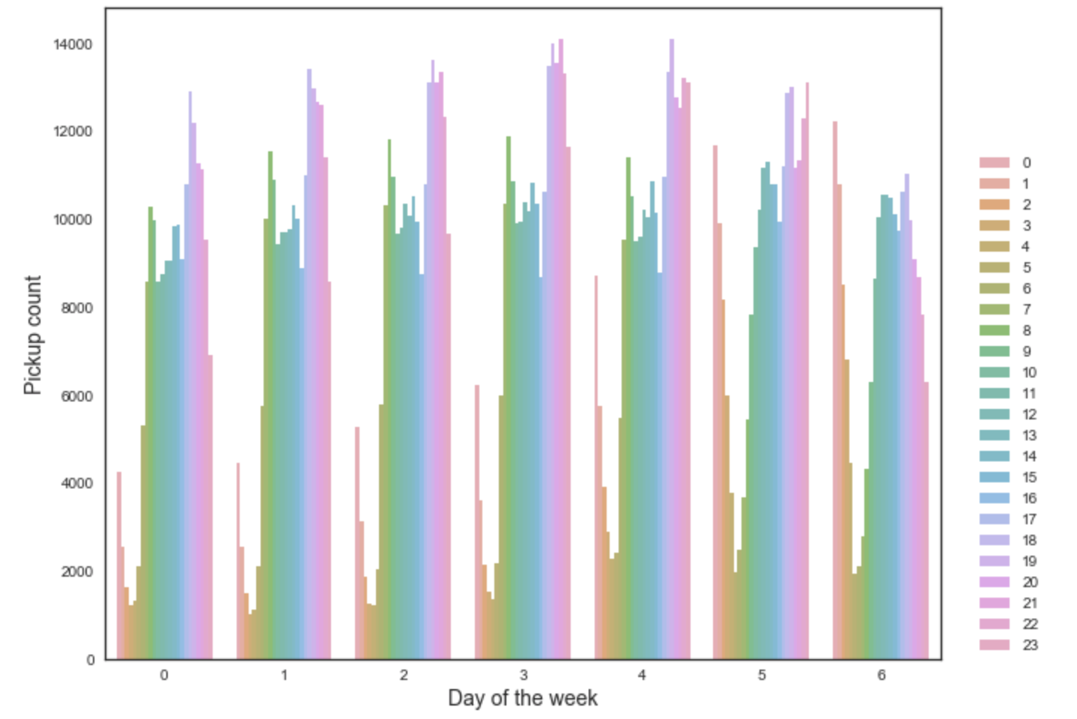
Distribution of Pickup Datetime over the Week

Slide 19
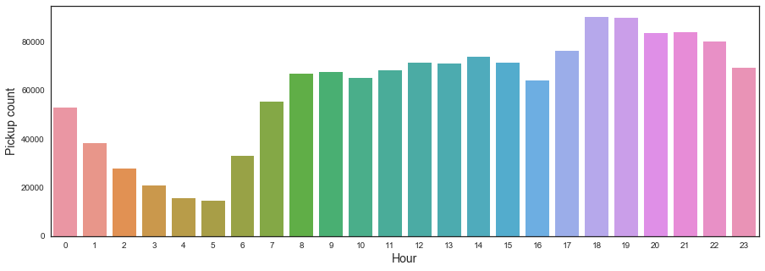
Distribution of Pickup Count over the Day

Slide 20
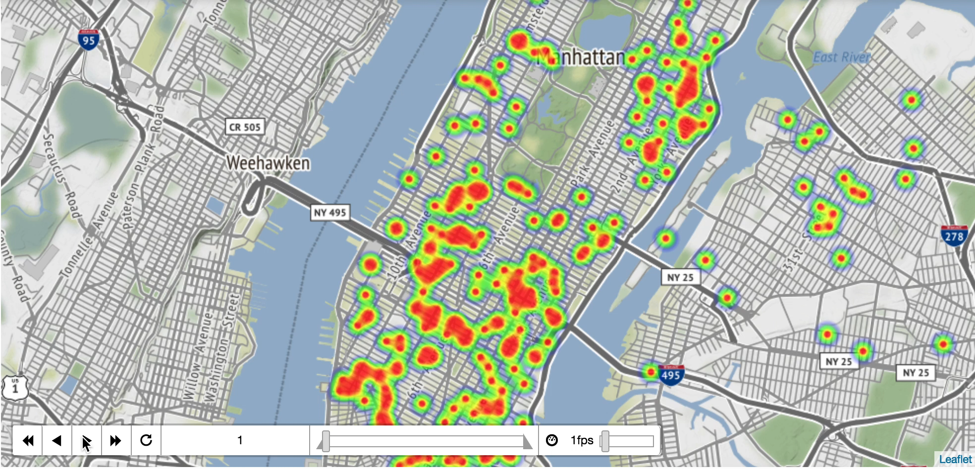
Heatmap of Pickup Time over the Day

Slide 21
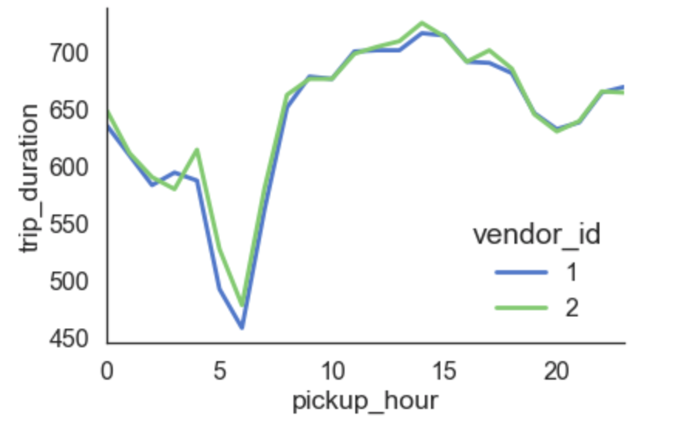
Distribution of Duration during the Day

Slide 22
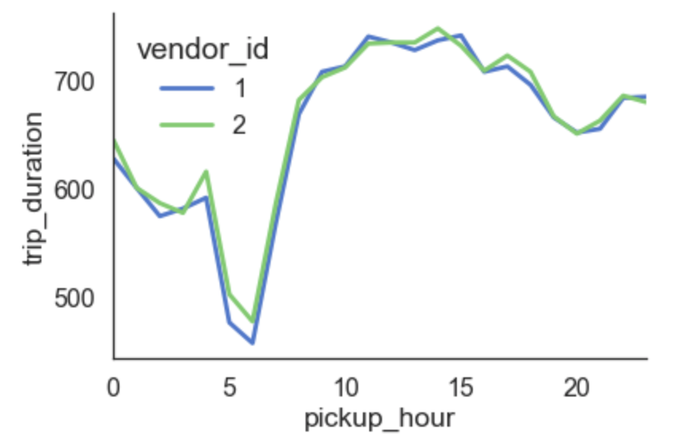
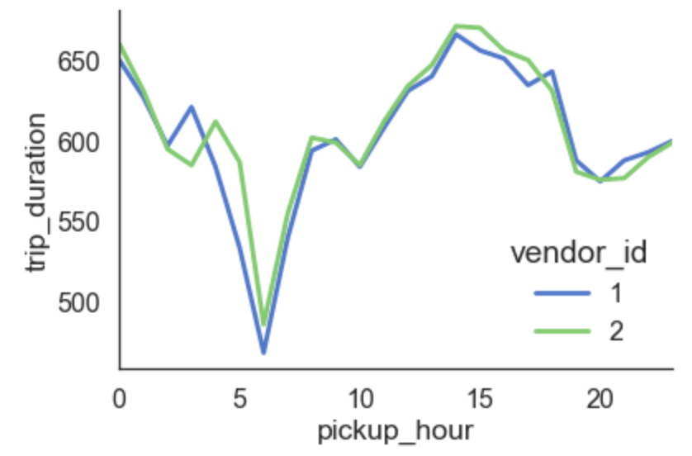
Weekday Duration vs. Weekend Duration
Weekdays
Weekends

Slide 23
Models
Ridge Regression
Random Forest
XGBoost

Slide 24
Models
—— Ridge Regression
most commonly used method of regularization of ill-posed problems
addresses some of the problems of Ordinary Least Squares by imposing a penalty on the size of coefficients.
* ordinary least squares (OLS) is a method for estimating the unknown parameters in a linear regression model.

Slide 25
Models
—— Random Forest
An ensemble learning method
Constructing a multitude of decision trees at training time and outputting the class that is the mode of mean prediction of the individual trees
Correct decision trees’ habit of overfitting

Slide 26
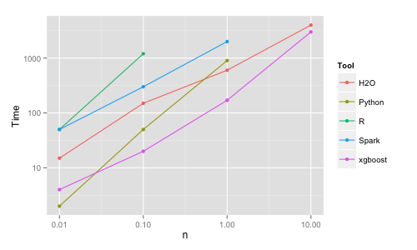
Models
—— XGBoost
short for “Extreme Gradient Boosting” / ensemble method
XGBoost is an implementation of gradient boosted decision trees designed for speed and performance.
Advantage:
Execution Speed.
Model Performance.
XGBoost was almost always faster than the other benchmarked implementations of gradient boosting and bagged decision trees from R, Python Spark and H2O.

Slide 27
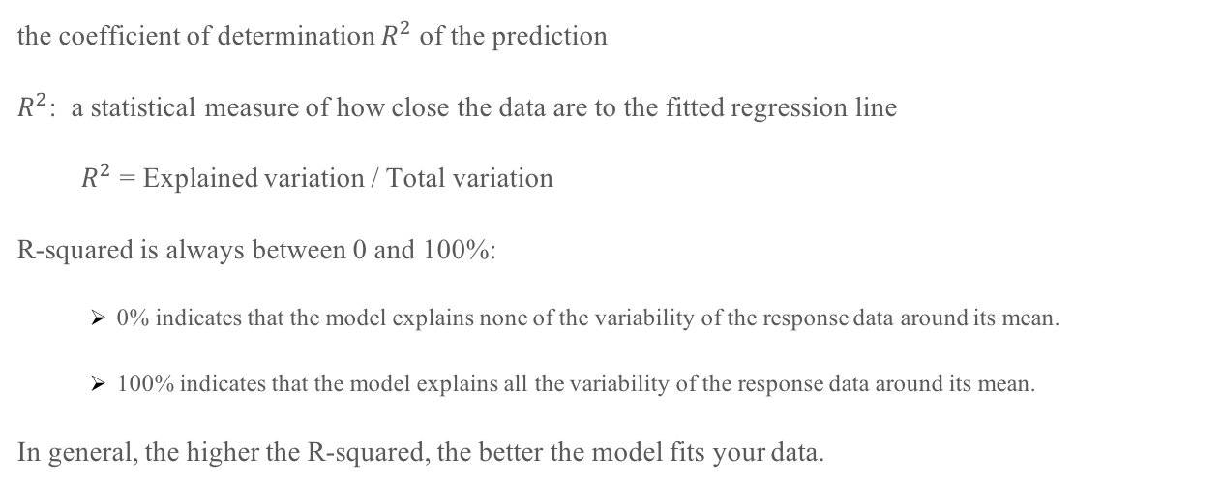
Models
—— Performance & Evaluation
the coefficient of determination $R^{2}$ of the prediction
$R^{2}$: a statistical measure of how close the data are to the fitted regression line
$R^{2}$ = Explained variation / Total variation
R-squared is always between 0 and 100%:
0% indicates that the model explains none of the variability of the response data around its mean.
100% indicates that the model explains all the variability of the response data around its mean.
In general, the higher the R-squared, the better the model fits your data.

Slide 28
Models
—— Performance & Evaluation
RMSE(root-mean-square error)
a frequently used measure of the differences between values predicted by a model and the values actually observed
indicates the absolute fit of the model to the data–how close the observed data points are to the model’s predicted values.
lower RMSE indicate better fit.

Slide 29
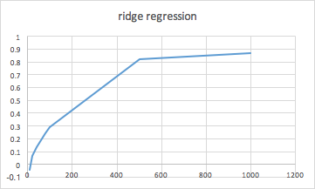
Models
—— Performance & Evaluation
r-square
#early_stopping_rounds

Slide 30
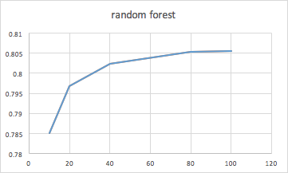
Models
—— Performance & Evaluation
r-square
#classifiers

Slide 31
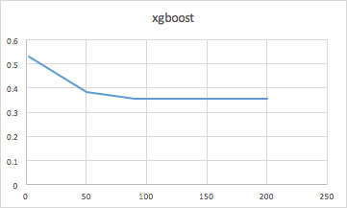
Models
—— Performance & Evaluation
rmse
#iterations

Slide 32
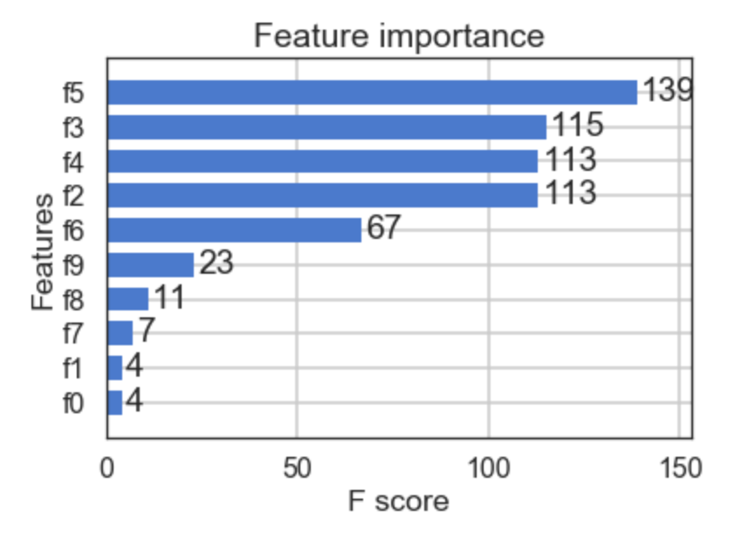
Models
—— Performance & Evaluation
f0: vendor_id f1: passenger_count
f2: pickup_longitude f3: pickup_latitude f4: dropoff_longitude f5: dropoff_latitude f6: pickup_hour f7: week_of_year f8: day_of_year
f9: day_of_week
Drop-off location
Pick-up location
Day of Week
Date
#passengers
#vendor

Slide 33
Models
—— Performance & Evaluation
Model | RMSE
Ridge Regression | 274.97
Random Forest | 107.12
XGBoost | 0.35

Slide 34
Feature Work
—— Performance & Evaluation
Experimental study:
Training part: size of training set vs performance, train weekday/weekends
Testing part: more evaluation method
RMSLE (Root Mean Squared Logarithmic Error)
usually used when you don't want to penalize huge differences in the predicted and true values when both predicted and true values are huge numbers.

Slide 35
Thank you!

